Slide 1
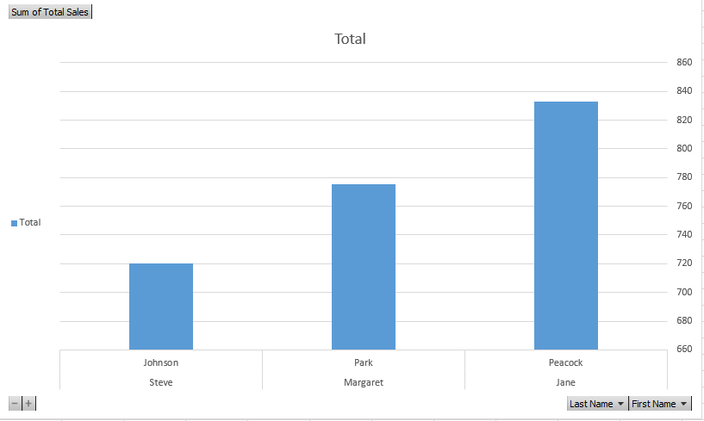
Who is the best selling Employee? and what is the total number of sales he made it?
As we see the best selling Employee is Jane Peacock with a total of sales of 833.

Slide 2
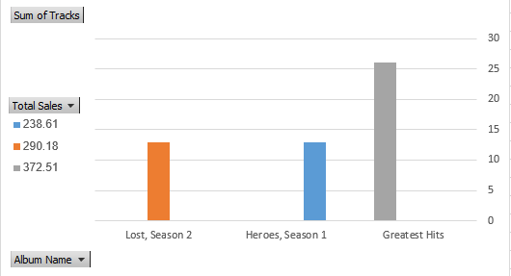
What is the best selling Album ? and what is it's total sales? and how many tracks does it contain ?
As we see the best selling album is Greatest Hits consists of 26 songs with total sales of 372.5 .

Slide 3
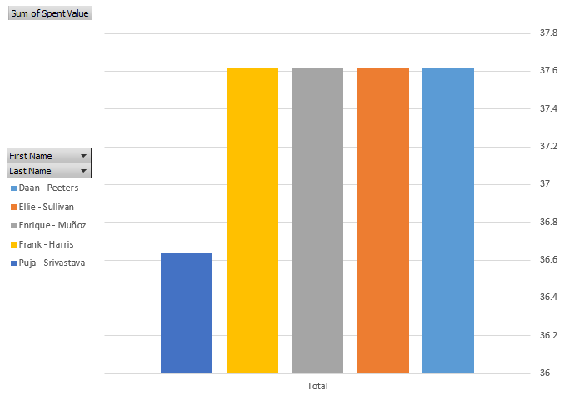
what is the least value spent by a customer and who spent it?
As we see the least value spent by Puja Srivastava which is total of 36.64 .

Slide 4
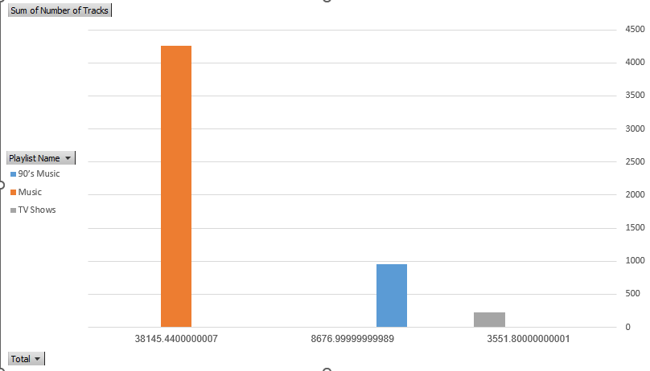
What is the top 3 popular playlist ? and how many songs does it contain?
As we see the most popular playlist is the Music playlist with 4258 songs and total sales of 38145.44, followed by 90’s Music playlist with 954 songs and total sales of 8677 and the last one is TV Shows playlist with 222 songs and total sales of 3552.

